Slide 1
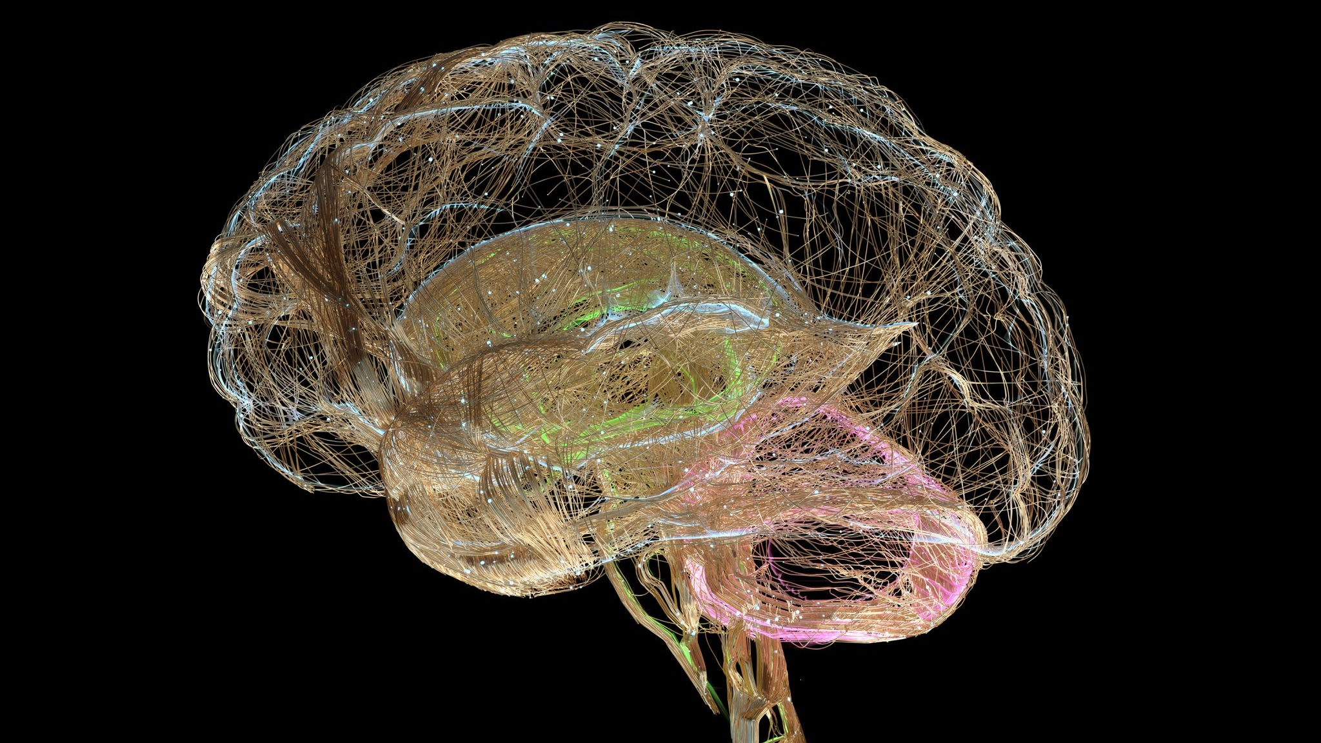
Brain Image Segmentation
Luc Ravenelle, Ido Tzhori, Isaya Acevedo, Jason Pereira

Slide 2
AGENDA
Background
Primary goals
Data Cleaning
Methodologies
Results

Slide 3
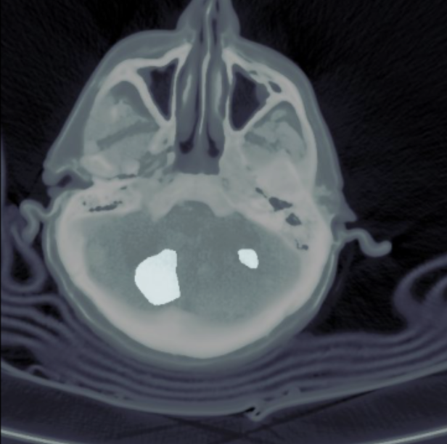
Background
XN Project – Brain CT Image Hemorrhage Classification and Segmentation
These hemorrhages are divided into different types: intraparenchymal, subarachnoid, subdural, epidural, and category for images with multiple sources of bleeding
How can we effectively use models and methods we have learned this semester to correctly identify and label hemorrhages in brain images?

Slide 4
PRIMARY GOALS
Classification
Image Segmentation

Slide 5
Data Processing and Cleaning

Slide 6
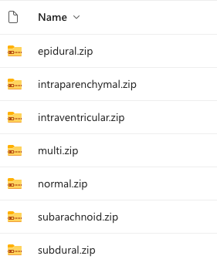
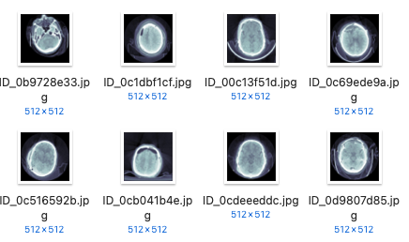
What Does the Data Look Like?
Hundreds of thousands of images to pick from – just under 10 GB of data!
Hemorrhage labels files for each type
Label files held important information:
Image file name
Labeling state
Correct/majority labels
Difficulty
Comments
etc

Slide 7
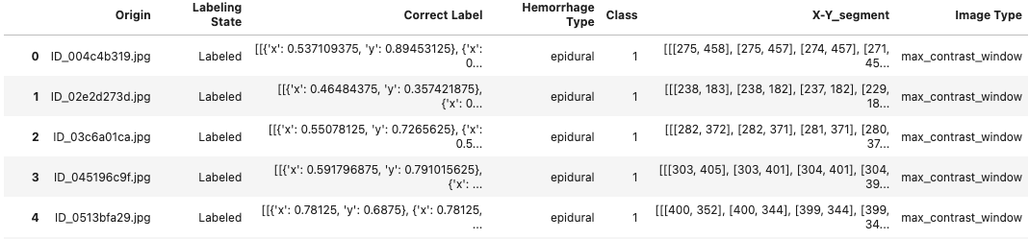
Cleaning Process
How can we transform a massive amount of data into a refined, clean and correct format for our models?​
Create a master list of images and their attributes (Pandas Dataframe)
Filter out information that we don’t need (Case ID, URL, etc.)
Filter to only include images with labels available that were also usable
Convert labels to a usable set of (x,y) coordinate values
Add a sample of normal images that matches sizes of other hemorrhage class's sizes
Drop duplicate data
Further processing to get format necessary for each model

Slide 8
Methodologies

Slide 9
Preliminary Classification Methods

Slide 10
Regression / LDA
Images were flattened and loaded into matrices of size 1835 x 262144
Class labels for each image
Training 85%, Test 15%
Multinomial Logistic Regression to classify brain hemorrhages
Limited Memory BFGS optimization algorithm
Sklearn library and GridSearchCV
Linear Discriminant Analysis to find a linear boundary to classify brain hemorrhages
Sklearn library

Slide 11
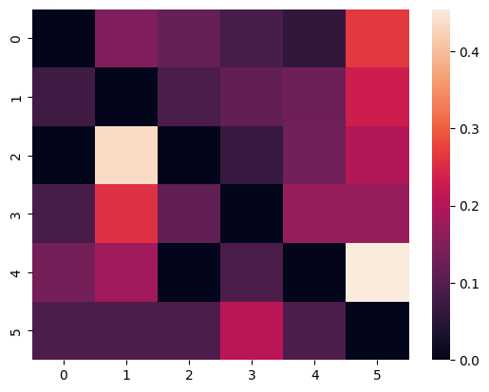
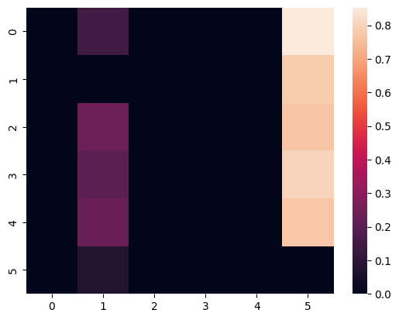
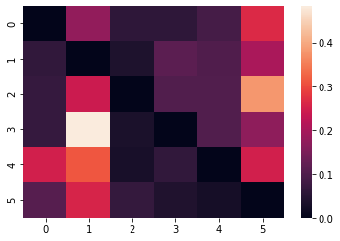
Results and Learnings
Accuracy of Logistic Regression: 31.5%
F1 score of Logistic Regression: 31.5%
Accuracy of LDA: 33.7%
F1 score of LDA: 0.35
Baseline default params for Logistic
GridsearchCV 'optimized' for Logistic
Baseline default params for LDA

Slide 12
More Powerful Methods

Slide 13
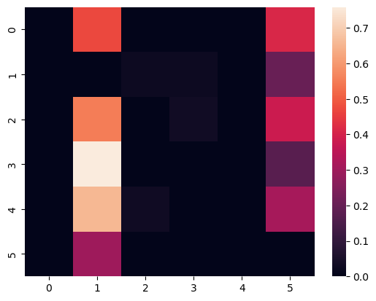
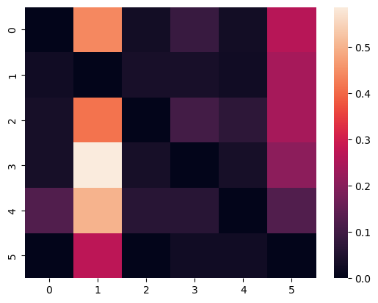
Random Forest / XGBoost
Random forest is a bagging methods that attempts to reduce overfitting by running multiple classifications tree​s.
XGBoost is a gradient boosting tree algorithm that builds multiple models and each model tries to predict the error left over by the previous one.
Random forest was tuned using grid search and XGBoost was tuned using hyperopt
Random Forest Accuracy: 42.5%
XGBoost Accuracy: 41.8%

Slide 14
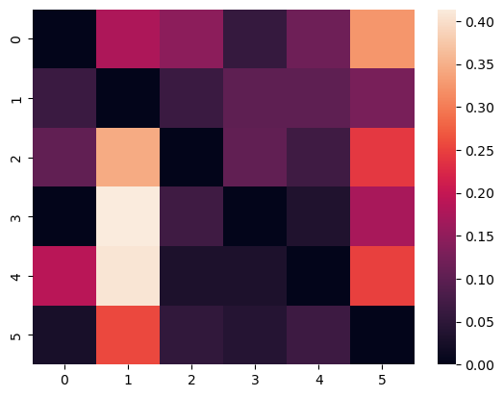
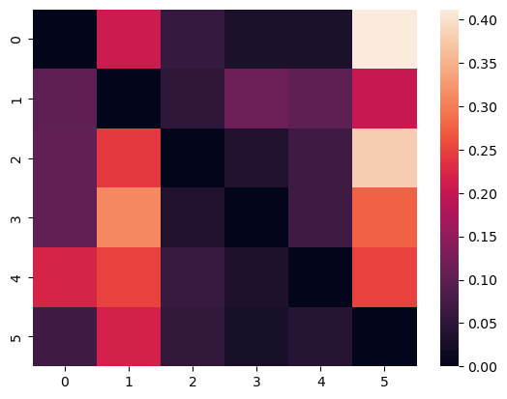
SVM / KNN
SVM finds a hyperplane that maximizes the margin between the two classes of data.
KNN finds the k nearest neighbors of a new data point and assigns the new data point to the class that is most common among its neighbors.
SVM and KNN were tuned using gridsearch
SVM best parameters
KNN best parameters

Slide 15
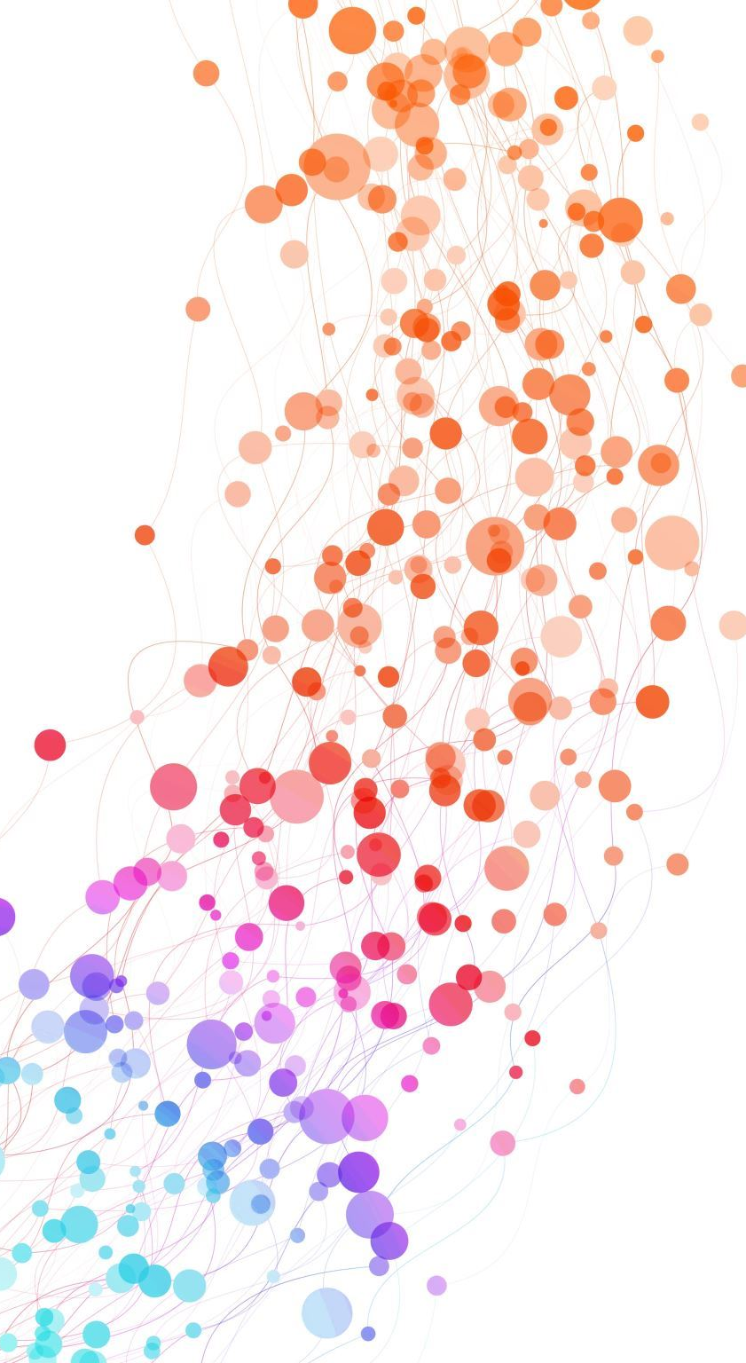
Convolutional Neural Network
CNN processes the data through multiple layers of filters to find patterns and uses those patterns to output classifications
Input size (256 x 256 x 3)
Pretrained CNN model using VGG16 and ImageNet
Used TensorFlow and Keras

Slide 16
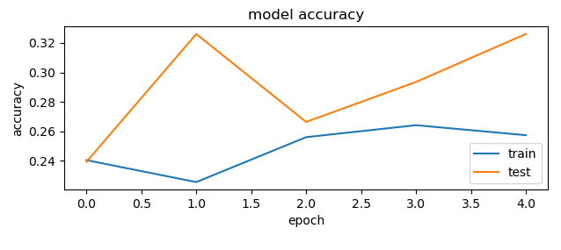
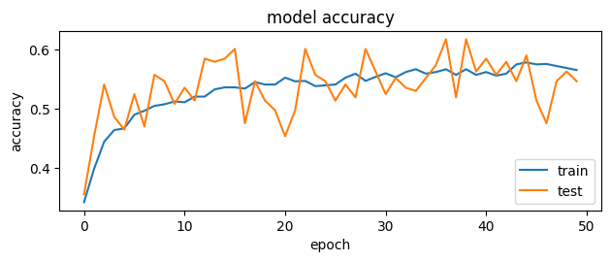
Results and Learnings
Accuracy: 33.23%
F1 score: 0.20
Accuracy: 61.83%
F1 score: 0.22

Slide 17
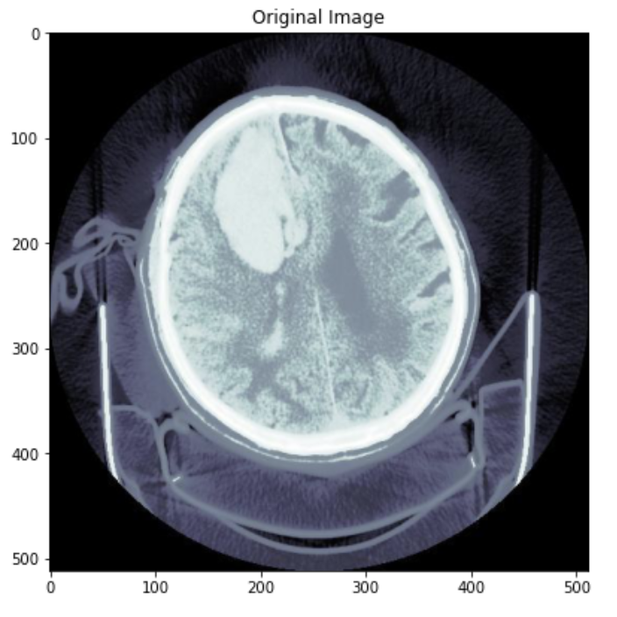
Image Segmentation
Where exactly is the hemorrhage?

Slide 18
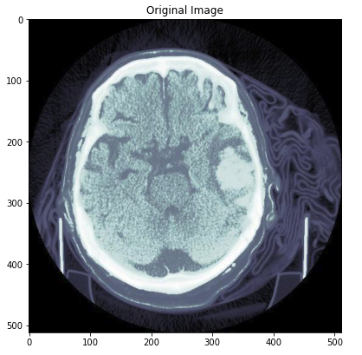
Importance
Early diagnosis
Vital for patient outcomes
Timely treatment reduces risk of complication
Reducing workload
Labor intensive
Cost effective

Slide 19
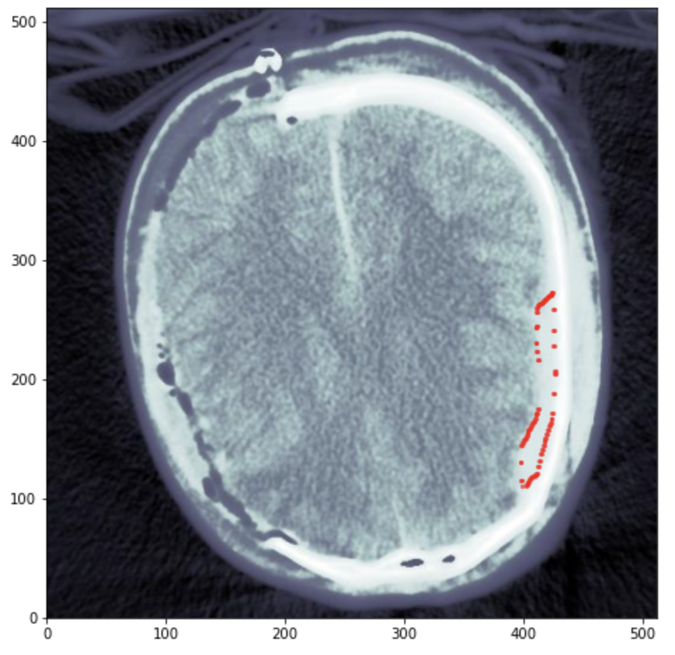
Pipeline
Exploratory Data Analysis
Identifying region of interest
Data cleaning
Training
Tuning
Repeat

Slide 20
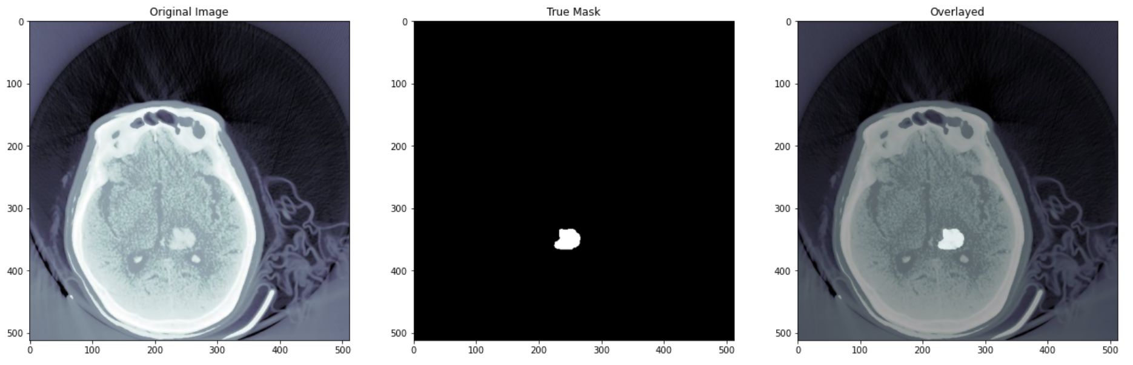
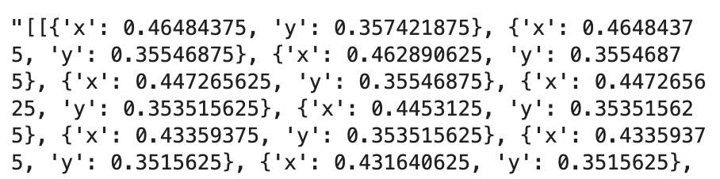
Data cleaning - Preprocessing
Look at bounding contours of each hemorrhage area
Combine areas with multiple, separate hemorrhage areas
Create a mask using OpenCV library
Assign pixel value (0 or 255)
Removing poor masks
Manual effort
Remove masks with too few hemorrhage pixels

Slide 21
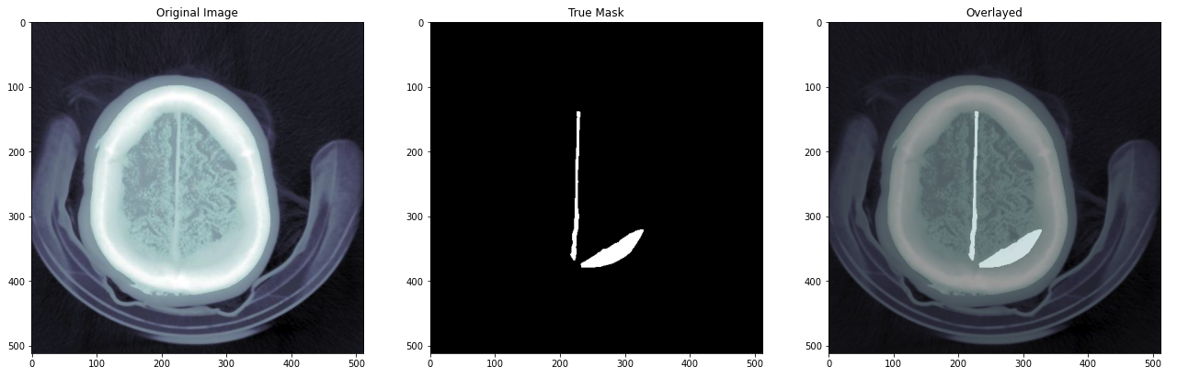
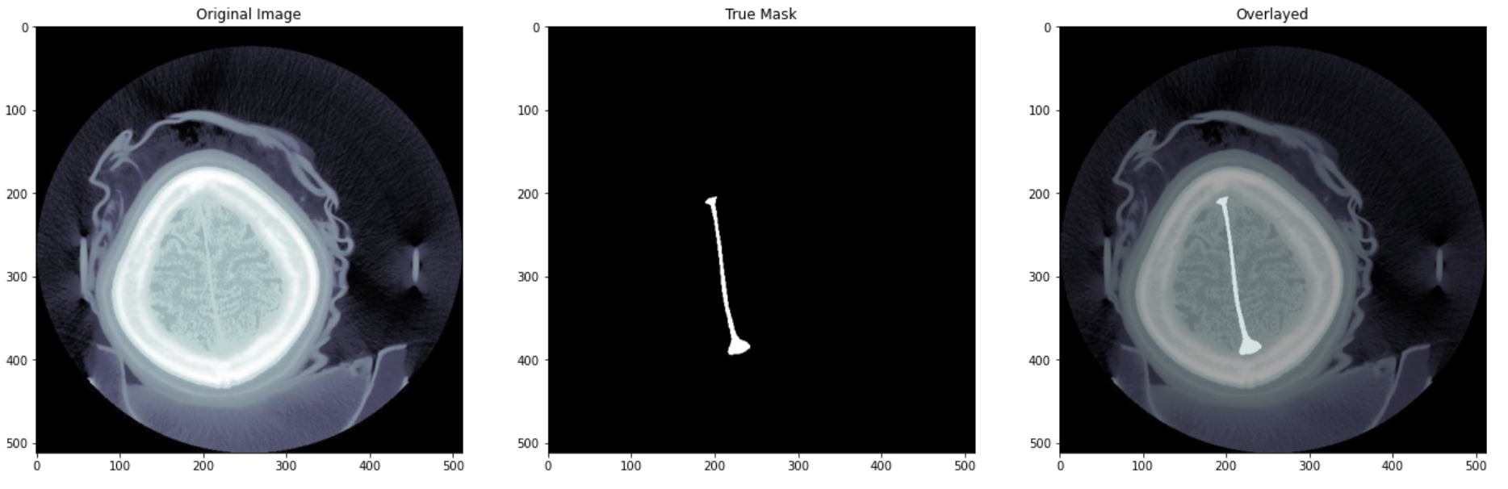
More Examples

Slide 22
Training and Fitting
Input size (512 x 512 x 3)
Every layer is pixel intensity at every color (RGB)
Sigmoid activation function for output of size (512 x 512 x 1)
Need to set threshold for best results
We want output to either be 0 (background) or 1 (hemorrhage)
X_train | X_test | y_train | y_test
(768, 512, 512, 3) | (86, 512, 512, 3) | (768, 512, 512, 1) | (86, 512, 512, 1)

Slide 23
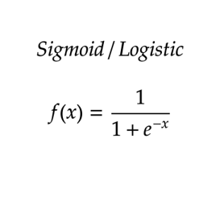
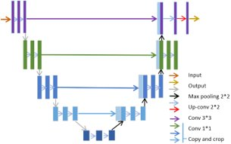
Model: U-net architecture
A type of CNN designed specifically for medical image segmentation
Encoder-decoder structure
Encoder captures context
Decoder focuses on localization of segment
Produces pixel-wise segmentation maps
Requires small dataset when compared to other deep learning models

Slide 24

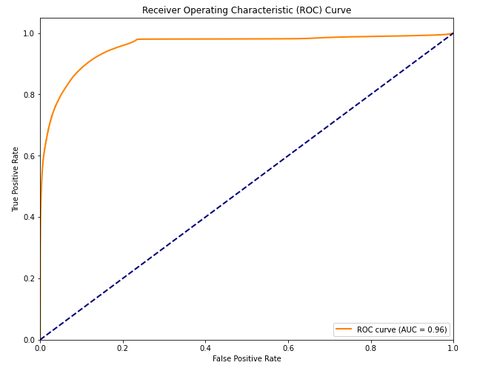
Metrics
Accuracy is not the best metric
Achieve 99% > accuracy by just predicting no hemorrhage
Recall (Sensitivity)
What % of hemorrhage did we find
Missing hemorrhage is severe
Precision
What % of our hemorrhage prediction was hemorrhage
F1 score
Harmonic mean of precision and recall
Dice Coefficient (IOU)
Spatial overlap between predicted segment and ground truth

Slide 25
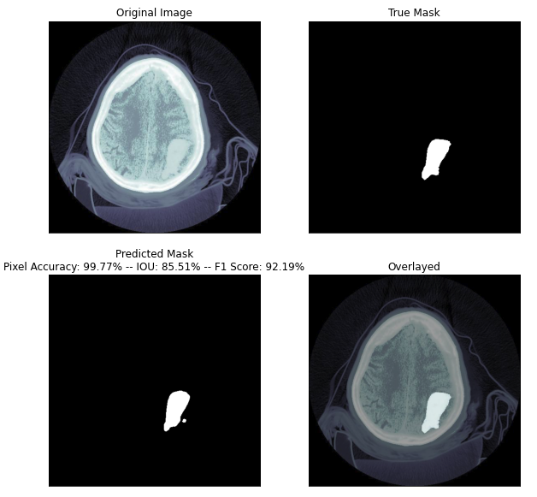
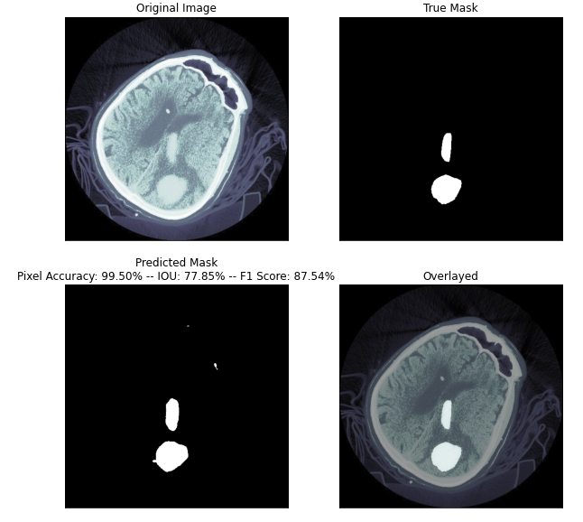
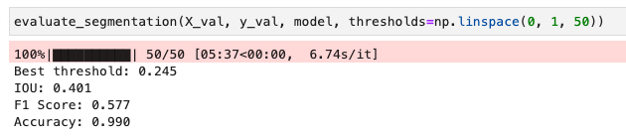
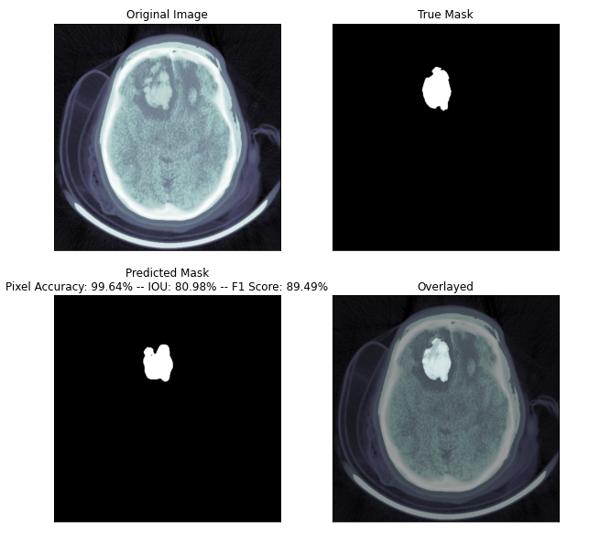
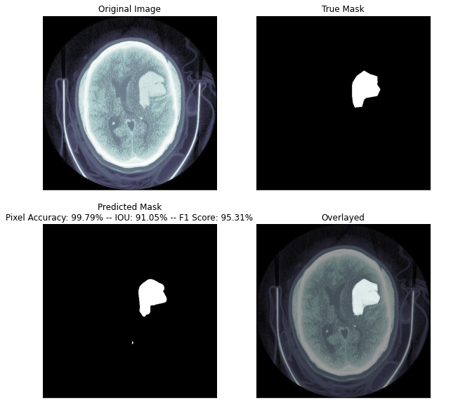
Results

Slide 26
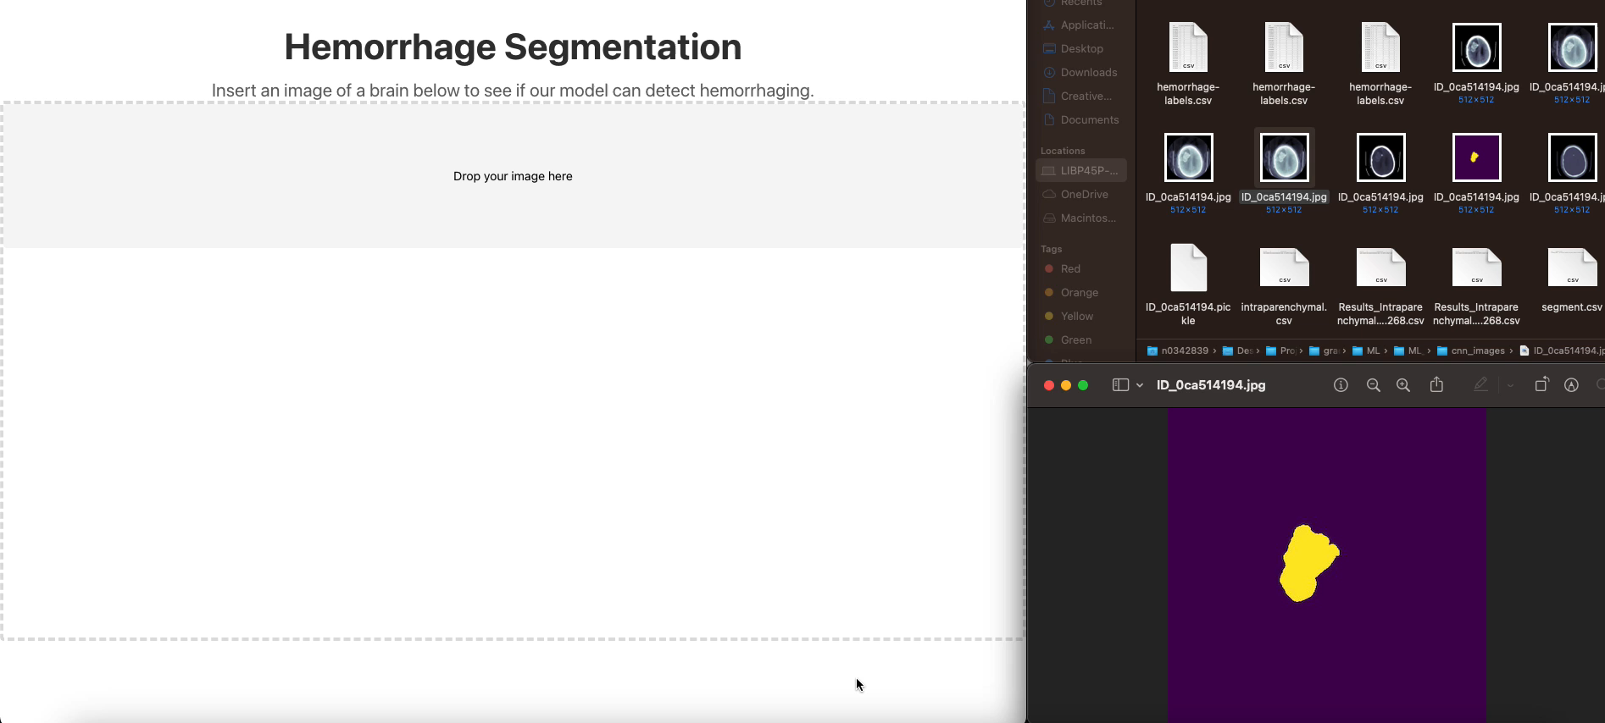
Bonus...

Slide 27
THANK YOU
GitHub: https://github.com/lrav35/ML_7243

